Slide 1
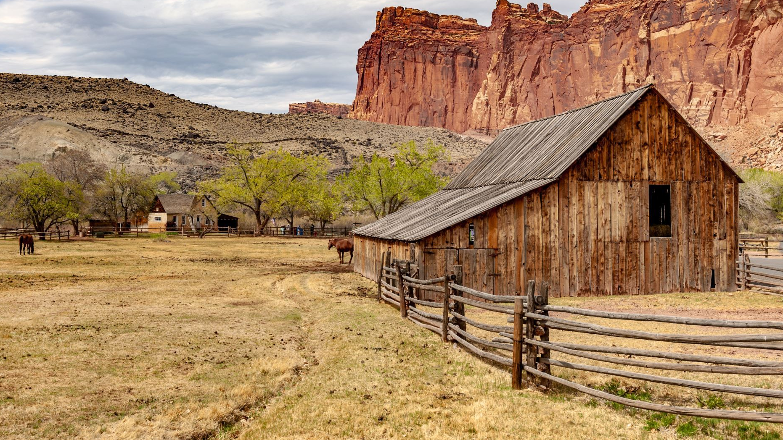
Outland Adventures
Team Silver:
Tyson B. - Cystal L. - Rashai R.

Slide 2
Introduction!
Hello CSD-310,
We are Team Silver, and our members are Tyson, Crystal, & Rashai.

Slide 3
Case Study brief
Hello CSD-310,
Our project is about a travel company known as Outland Adventures. Outland Adventures was started by Blythe Timmerson and Jim Ford. It was their hobby at first but became successful enough to become their fulltime occupations. They now have 5 employees.
Blythe and Jim want to optimize the company, so they have a few questions like:
Should we keep selling equipment?
Which location is least booked?
How old is our inventory?

Slide 4
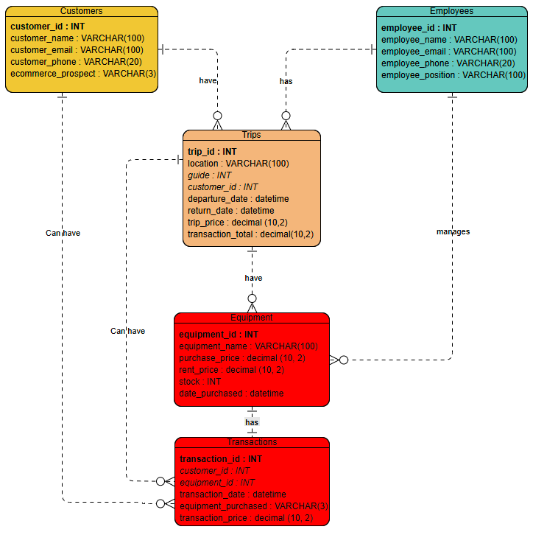
ERD

Slide 5
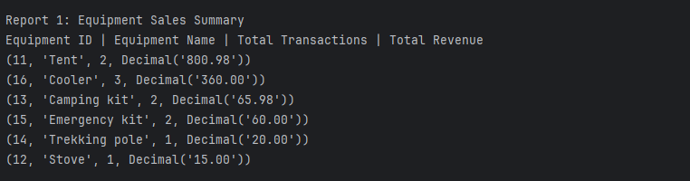
Report 1
Our first report shows equipment sales.
We wanted to see if our customers benefit from us keeping equipment on hand for sale. This is because we also rent equipment.
These are our sales so far this year.

Slide 6
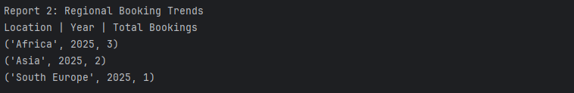
Report 2
Our second report shows booking trends.
We wanted to see which locations our customers favor the most, and which they favor the least.
As you can see, South Europe is the least favorite travel location of our customer so far this year.

Slide 7
Report 3
Our third report shows equipment age.
Safety is key, and we wanted to know what equipment items might need replacing soon.
Only one category in our items is still here five years after our purchase date. It's important to note that we rent items as well, so these may only be the rentals and not equipment for sale.

Slide 8
Assumptions
Something to track booking
Each product will need its own id for the program
Employees can only manage order entry but not suppliers or inventory updates
Equipment can either be sold or rented to customers.
A customer can purchase or rent multiple equipment items.
Equipment has a purchase date and allows age tracking.
Each piece of equipment has a stock quantity.

Slide 9
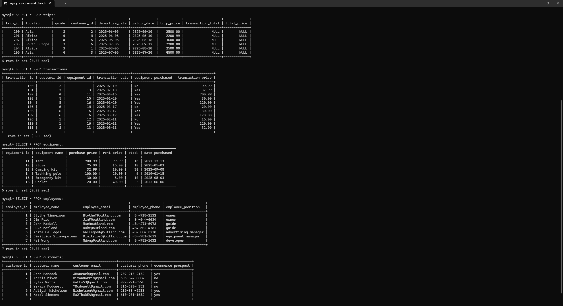
SQL Query

Slide 10
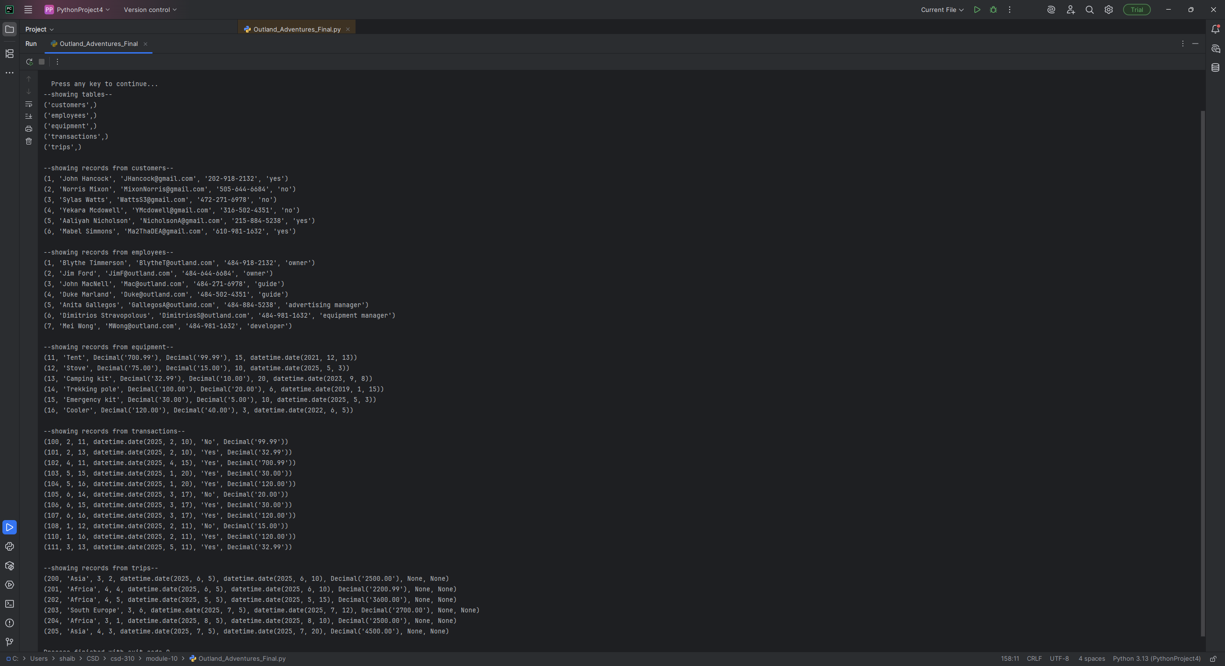
Python results

Slide 11
The End. Thanks!

